Slide 1

Government College of Engineering and Research
Department of Computer Engineering, Avasari
DATABASE MANAGEMENT SYSTEM
TE 2019 Course
Prof.K.B.Sadafale
Assistant Professor

Slide 2
Syllabus
Unit I: Introduction to Database Management Systems and ER Model
UNIT II: SQL and PL/SQL
UNIT III: Relational Database Design
UNIT IV: Database Transaction Management
UNIT V: NoSQL Databases
UNIT VI: Advances in Databases

Slide 3
UNIT VI: Advances in Databases
Emerging Databases: Active and Deductive Databases, Main Memory Databases, Semantic Databases.
Complex Data Types:
Semi-Structured Data, Features of Semi-Structured Data Models.
Nested Data Types: JSON, XML. Object Orientation: Object-Relational Database System, Table Inheritance, Object- Relational Mapping.
Spatial Data: Geographic Data, Geometric Data.

Slide 4
Active Databases
An active Database is a database consisting of a set of triggers.
These databases are very difficult to be maintained because of the complexity that arises in understanding the effect of these triggers.
In such database, DBMS initially verifies whether the particular trigger specified in the statement that modifies the database is activated or not, prior to executing the statement.
If the trigger is active then DBMS executes the condition part and then executes the action part only if the specified condition is evaluated to true.

Slide 5
It is possible to activate more than one trigger within a single statement.
In such situation, DBMS processes each of the trigger randomly.
The execution of an action part of a trigger may either activate other triggers or the same trigger that Initialized this action.
Such types of trigger that activates itself is called as ‘recursive trigger’.
The DBMS executes such chains of trigger in some pre-defined manner but it effects the concept of understanding.

Slide 6
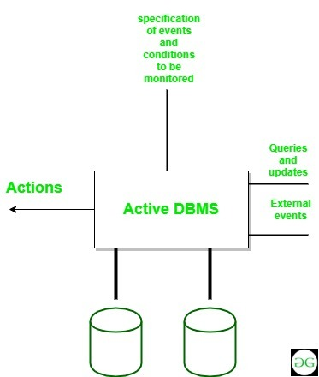


Slide 7
Features of Active Database:
It possess all the concepts of a conventional database i.e. data modelling facilities, query language etc.
It supports all the functions of a traditional database like data definition, data manipulation, storage management etc.
It detects event occurrence.
It must be able to evaluate conditions and to execute actions.
It means that it has to implement rule execution.
Examples of Active Databases:
Real-time Databases
In-Memory Databases
Transactional Databases
Time-series Databases

Slide 8
1.Real-time Databases:
Oracle TimesTen: A relational database that runs in memory and is intended for real-time applications that need response times of less than one millisecond.
VoltDB: A lightning-fast in-memory database for instantaneous analytics and data processing.
2.In-Memory Databases:
SAP HANA: A column-oriented, in-memory relational database management system for processing large amounts of data and real-time analytics.
MemSQL: Uses in-memory processing for real-time data insights, combining analytics and transactions on a single platform.

Slide 9
3.Transactional Databases:
MySQL Cluster: Offers automatic sharding and synchronous replication for high availability and real-time data access.
Microsoft SQL Server with Always On: High availability and disaster recovery are provided by Microsoft SQL Server with Always On, which enables real-time read access to replicated databases.
4.Time-series Databases:
InfluxDB: For time-stamped data, InfluxDB is designed to withstand heavy write and query loads.
It is frequently utilized in IoT and monitoring applications.
Prometheus: A toolkit for alerting and monitoring that keeps track of time series data and is used to analyze and monitor systems in real time.
These databases and platforms support a variety of real-time data handling requirements, including high-throughput stream processing, low-latency transaction processing, and event-driven architectures.

Slide 10
Advantages :
Enhances traditional database functionalities with powerful rule processing capabilities.
Enable a uniform and centralized description of the business rules relevant to the information system.
Avoids redundancy of checking and repair operations.
Suitable platform for building large and efficient knowledge base and expert systems.

Slide 11
Deductive database
A deductive database is a database system that can make deductions (i.e. conclude additional facts) based on rules and facts stored in its database.
Data log is the language typically used to specify facts, rules and queries in deductive databases.
Deductive databases have grown out of the desire to combine logic programming with relational databases to construct systems that support a powerful formalism and are still fast and able to deal with very large datasets.
Deductive databases are more expressive than relational databases but less expressive than logic programming systems such as Prolog.
In recent years, deductive databases have found new application in data integration, information extraction, networking, program analysis, security, and cloud computing.

Slide 12
Active Databases | Deductive Databases
Definition: Active databases are equipped with rules and triggers that automatically respond to certain events or changes in the database. | Definition: Deductive databases focus on deriving new information from existing data using logical inference. They combine database capabilities with logic programming.
Mechanism: They use event-driven programming, where specific conditions (events) trigger actions (rules) automatically without user intervention. | Mechanism: They use rules and facts to infer new data. Queries can involve logical reasoning, allowing users to retrieve not just stored data but also deduced information.
Use Cases: Commonly used for applications that require immediate responses, like monitoring systems, fraud detection, or automated workflows. | Use Cases: Often used in artificial intelligence applications, expert systems, and situations where complex queries and relationships between data are involved.
Features: They often include support for triggers, constraints, and rules, allowing them to enforce business logic directly within the database. | Features: Typically include a logical programming language (like Prolog) for rule definition and inference, and support for backward chaining (inferring data based on rules).

Slide 13
Here are some databases and systems commonly used as active databases:
1. Oracle Database
2. PostgreSQL
3. Microsoft SQL Server
4. MySQL
5. IBM Db2
6. Firebird
7. Cassandra (with custom triggers)

Slide 14
Here are some databases and systems commonly used as deductive databases:
1. Prolog
2. Datalog
3. SQLite (with extensions)
4. XSB
5. RDF (Resource Description Framework) with SPARQL
6. Choco-3

Slide 15
Main Memory Databases
A main memory database (MMDB), also known as an in-memory database (IMDB).
Is a database that stores data in the main memory (RAM) of a computer.
In-memory databases (IMDBs) are databases that primarily rely on main memory (RAM) for data storage, rather than traditional disk storage.
This design choice significantly enhances performance, enabling faster data access and processing speeds.
This allows for faster response times than traditional databases that store data on disk.
A main memory database system is a DBMS that primarily relies on main memory for computer data storage.
In contrast, conventional database management systems typically employ hard disk based persistent storage.

Slide 16
Key features of In-memory databases (IMDBs)
Speed: IMDBs provide rapid data retrieval and manipulation due to the low latency of RAM compared to disk storage.
Data Structures: They often use optimized data structures (like key-value stores, columnar databases) to further enhance performance.
Real-time Processing: IMDBs are ideal for applications requiring real-time analytics, such as financial transactions, online gaming, and IoT data processing.
Persistence Options: Many IMDBs offer mechanisms for data persistence, allowing snapshots or logs to be written to disk to prevent data loss.
Concurrency: They typically support high levels of concurrency, making them suitable for applications with many simultaneous users.

Slide 17
Why Use an In-Memory Database?
Applications that manage vast quantities of data and require rapid response times can benefit from in-memory database architecture.
The data analytics industry increasingly relies on in-memory database systems.
The benefits of an in-memory database include:
Faster transactions
No translation
Multi-user concurrency

Slide 18
In-memory databases are commonly used for:
Real-time banking, retail, advertising, medical device analytics, machine learning and billing/subscriber applications
Online interactive gaming
Geospatial/GIS processing
Processing of streaming sensor data
Developing embedded software systems
Applications in transport systems, network switches and routers
Fulfilling the requirements of e-commerce applications

Slide 19
Semantic database
A semantic database is a database that stores, organizes, and interprets data based on its meaning.
Semantic databases use semantic technology to provide context to data, which can improve data analysis and retrieval.
The concept of Semantic Databases is rooted in semantic data models, which emerged in the late 1970s and early 1980s as a response to the limitations of relational databases.
These databases aimed at understanding the data beyond its structure, focusing on relationships and meanings to deliver more insightful data interpretation.

Slide 20
A semantic data model is a database model that uses semantics to structure and describe databases.
It's also known as an information model, and in linked data technology, it's called an ontology.
Semantic modeling matters when you want to capture more meaning out of your data.
It defines data within the context of the real world and brings relationships to the surface.
A semantic data model is built upon concepts and meanings, unlike the traditional data model which is based on tables, columns, and rows.

Slide 21
Here are a few notable examples of semantic databases:
Apache Jena
GraphDB
Blazegraph
Stardog
Neo4j
RDF Stores: Resource Description Framework (RDF) databases like Apache Jena and RDF4J store data as triples (subject, predicate, object), allowing complex relationships to be represented. For example, "Alice (subject) is a friend of (predicate) Bob (object).“
Graph Databases: Neo4j is a graph database that allows users to create and query data as nodes and edges, making it easy to model relationships. For instance, you could represent users and their friendships or interests.

Slide 22
Semi structured data
Semi-structured data refers to data that is not captured or formatted in conventional ways.
Semi-structured data does not follow the format of a tabular data model or relational databases because it does not have a fixed schema.
HTML code, graphs , e-mails, XML documents are examples of semi-structured data, which are often found in object-oriented databases.

Slide 23
Characteristics of semi-structured Data:
Data does not conform to a data model but has some structure.
Data can not be stored in the form of rows and columns as in Databases
Semi-structured data contains tags and elements (Metadata) which is used to group data and describe how the data is stored
Similar entities are grouped together and organized in a hierarchy
Entities in the same group may or may not have the same attributes or properties
Does not contain sufficient metadata which makes automation and management of data difficult
Size and type of the same attributes in a group may differ
Due to lack of a well-defined structure, it can not used by computer programs easily

Slide 24
Sources of semi-structured Data:
E-mails
XML and other markup languages
Binary executables
TCP/IP packets
Zipped files
Integration of data from different sources
Web pages

Slide 25
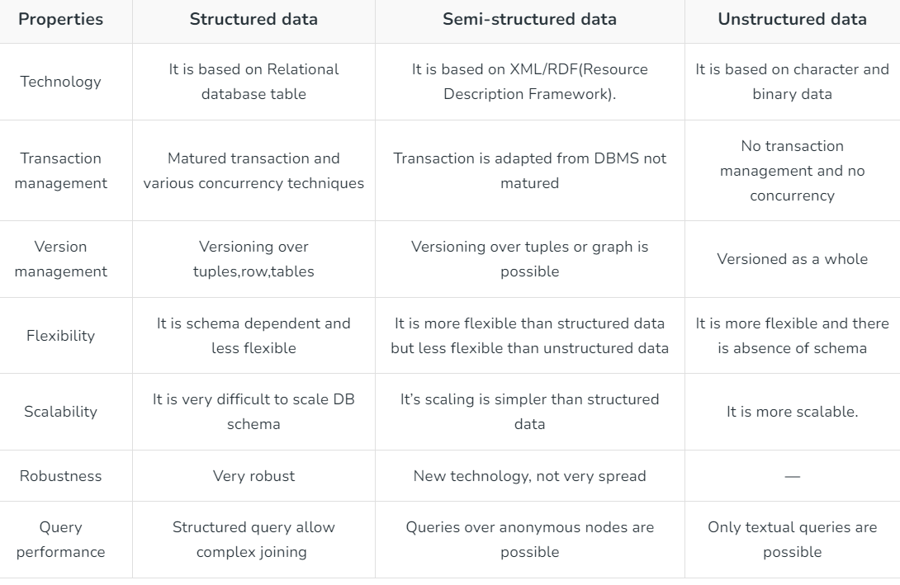
Differences between Structured, Semi-structured and Unstructured data:

Slide 26
Nested Data type
JSON
XML

Slide 27
JSON
JSON stands for JavaScript Object Notation
JSON is a text format for storing and transporting data
JSON is "self-describing" and easy to understand
JSON (JavaScript Object Notation) is a lightweight data-interchange format.
It is easy for humans to read and write.
It is easy for machines to parse and generate.
It is based on a subset of the JavaScript Programming Language Standard.
JSON is a text format that is completely language independent but uses conventions that are familiar to programmers of the C-family of languages, including C, C++, C#, Java, JavaScript, Perl, Python, and many others.
These properties make JSON an ideal data-interchange language

Slide 28
JSON Example
This example is a JSON string:
'{"name":"John", "age":30, "car":null}‘
It defines an object with 3 properties:
name
age
car
Each property has a value.
The JSON syntax is derived from JavaScript object notation, but the JSON format is text only.
Code for reading and generating JSON exists in many programming languages.

Slide 29
Why Use JSON?
The JSON format is syntactically similar to the code for creating JavaScript objects. Because of this, a JavaScript program can easily convert JSON data into JavaScript objects.
Since the format is text only, JSON data can easily be sent between computers, and used by any programming language.
JavaScript has a built in function for converting JSON strings into JavaScript objects:
JSON.parse()
JavaScript also has a built in function for converting an object into a JSON string:
JSON.stringify()

Slide 30
JSON syntax is derived from JavaScript object notation syntax:
Data is in name/value pairs
Data is separated by commas
Curly braces hold objects
Square brackets hold arrays
JSON data is written as name/value pairs (aka key/value pairs).
A name/value pair consists of a field name (in double quotes), followed by a colon, followed by a value:
"name":"John“

Slide 31
In JSON, values must be one of the following data types:
a string
a number
an object
an array
a boolean
null
In JavaScript values can be all of the above, plus any other valid JavaScript expression, including:
a function
a date
undefined

Slide 32
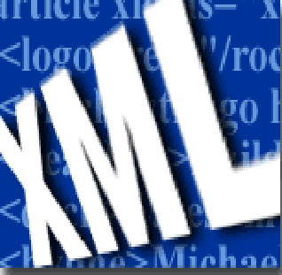
XML

Slide 33
XML stands for EXtensible Markup Language.
XML was designed to describe data.
XML is a software- and hardware-independent tool for carrying information.
HTML was designed to display data.
XML is a markup language much like HTML
XML was designed to describe data, not to display data
XML tags are not predefined. You must define your own tags
XML is designed to be self-descriptive
XML is a W3C Recommendation

Slide 34
XML documents are used to transfer data from one place to another often over the Internet.
XML Document Example
<?xml version="1.0" encoding="UTF-8"?>
<note>
<to> Tove</to>
<from>Jani</from>
<heading>Reminder</heading>
<body>Don't forget me this weekend!</body>
</note>
The above example is a note to Tove, from Jani, stored as XML:
The note above is quite self descriptive. It has sender and receiver information, it also has a heading and a message body.
But still, this XML document does not DO anything. It is just information wrapped in tags. Someone must write a piece of software to send, receive or display it.

Slide 35
XML Documents
What‘s in an XML document?
Elements
Attributes
plus some other details

Slide 36
A Simple XML Document
<article>
<author>Gerhard Weikum</author>
<title>The Web in Ten Years</title>
<text>
<abstract>In order to evolve...</abstract>
<section number=“1” title=“Introduction”>
The <index>Web</index> provides the universal...
</section>
</text>
</article>

Slide 37
A Simple XML Document
<article>
<author>Gerhard Weikum</author>
<title>The Web in Ten Years</title>
<text>
<abstract>In order to evolve...</abstract>
<section number=“1” title=“Introduction”>
The <index>Web</index> provides the universal...
</section>
</text>
</article>
Freely definable tags

Slide 38
A Simple XML Document
<article>
<author>Gerhard Weikum</author>
<title>The Web in Ten Years</title>
<text>
<abstract>In order to evolve...</abstract>
<section number=“1” title=“Introduction”>
The <index>Web</index> provides the universal...
</section>
</text>
</article>
Start Tag
Content of the Element (Subelements and/or Text)
End Tag
Element

Slide 39
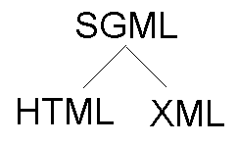
Standard Generalized Markup Language (SGML)

Slide 40
The Difference Between XML and HTML
XML is not a replacement for HTML.
XML and HTML were designed with different goals:
XML was designed to describe data, with focus on what data is
HTML was designed to display data, with focus on how data looks
HTML is about displaying information, while XML is about carrying information
HTML tags have a fixed meaning and browsers know what it is.
XML tags are different for different applications, and users know what they mean.
HTML tags are used for display.
XML tags are used to describe documents and data.

Slide 41
Example of an HTML Document
<html>
<head><title>Example</title></head>.
<body>
<h1>This is an example of a page.</h1>
<h2>Some information goes here.</h2>
</body>
</html>

Slide 42
Example of an XML Document
<?xml version=“1.0”/>
<address>
<name>Alice Lee</name>
<email>alee@aol.com</email>
<phone>212-346-1234</phone>
<birthday>1985-03-22</birthday>
</address>

Slide 43
XML Syntax Rules
All XML Elements Must Have a Closing Tag
In HTML, some elements do not have a closing tag:
<p>This is a paragraph.
<br>
In XML, it is illegal to omit the closing tag.
All elements must have a closing tag:
<p>This is a paragraph.</p>
<br />
XML Tags are Case Sensitive
The tag <Letter> is different from the tag <letter>.
Opening and closing tags must be written with the same case:
<Message>This is incorrect</message>
<message>This is correct</message>

Slide 44
XML Elements Must be Properly Nested
In HTML, you might see improperly nested elements:
<b><i>This text is bold and italic</b></i>
In XML, all elements must be properly nested within each other:
<b><i>This text is bold and italic</i></b>
XML Documents Must Have a Root Element
XML documents must contain one element that is the parent of all other elements.
This element is called the root element.
<root>
<child>
<subchild>.....</subchild>
</child>
</root>

Slide 45
XML Attribute Values Must be Quoted
XML elements can have attributes in name/value pairs just like in HTML.
In XML, the attribute values must always be quoted.
INCORRECT:
<note date=12/11/2007>
<to>Tove</to>
<from>Jani</from>
</note>
CORRECT:
<note date="12/11/2007">
<to>Tove</to>
<from>Jani</from>
</note>
The error in the first document is that the date attribute in the note element is not quoted.

Slide 46
Entity References
Some characters have a special meaning in XML.
If you place a character like "<" inside an XML element, it will generate an error because the parser interprets it as the start of a new element.
This will generate an XML error:
<message>if salary < 1000 then</message>
To avoid this error, replace the "<" character with an entity reference:
<message>if salary &lt; 1000 then</message>
There are 5 pre-defined entity references in XML:
&lt; | < | less than
&gt; | > | greater than
&amp; | & | ampersand
&apos; | ' | apostrophe
&quot; | " | quotation mark

Slide 47
Comments in XML
The syntax for writing comments in XML is similar to that of HTML.
<!-- This is a comment -->
White-space is Preserved in XML
XML does not truncate multiple white-spaces in a document (while HTML truncates multiple white-spaces to one single white-space):
XML: | Hello Tove
HTML: | Hello Tove

Slide 48

Well Formed XML
XML documents that conform to the syntax rules above are said to be "Well Formed" XML documents.

Slide 49
What is an XML Element?
An XML element is everything from (including) the element's start tag to (including) the element's end tag.
An element can contain:
other elements
text
attributes
or a mix of all of the above...

Slide 50
<bookstore>
<book category="CHILDREN">
<title>Harry Potter</title>
<author>J K. Rowling</author>
<year>2005</year>
<price>29.99</price>
</book>
<book category="WEB">
<title>Learning XML</title>
<author>Erik T. Ray</author>
<year>2003</year>
<price>39.95</price>
</book>
</bookstore>
In the example above, <bookstore> and <book> have element contents, because they contain other elements.
<book> also has an attribute (category="CHILDREN").
<title>, <author>, <year>, and <price> have text content because they contain text.

Slide 51
Empty XML Elements
An element with no content is said to be empty.
In XML, you can indicate an empty element like this:
<element></element>
or you can use an empty tag, like this (this sort of element syntax is called self-closing):
<element />
The two forms above produce identical results in an XML parser.
XML Naming Rules
XML elements must follow these naming rules:
Element names are case-sensitive
Element names must start with a letter or underscore
Element names cannot start with the letters xml (or XML, or Xml, etc)
Element names can contain letters, digits, hyphens, underscores, and periods
Element names cannot contain spaces
Any name can be used, no words are reserved (except xml).

Slide 52
XML Attributes
XML elements can have attributes, just like HTML.
Attributes provide additional information about an element.
In HTML, attributes provide additional information about elements:
<img src="computer.gif">
<a href="demo.asp">
Attributes often provide information that is not a part of the data.

Slide 53
XML Attributes Must be Quoted
Attribute values must always be quoted.
Either single or double quotes can be used.
For a person's gender, the person element can be written like this:
<person gender="female">
or like this:
<person gender='female'>
If the attribute value itself contains double quotes you can use single quotes, like in this example:
<gangster name='George "Shotgun" Ziegler'>
or you can use character entities:
<gangster name="George &quot;Shotgun&quot; Ziegler">

Slide 54
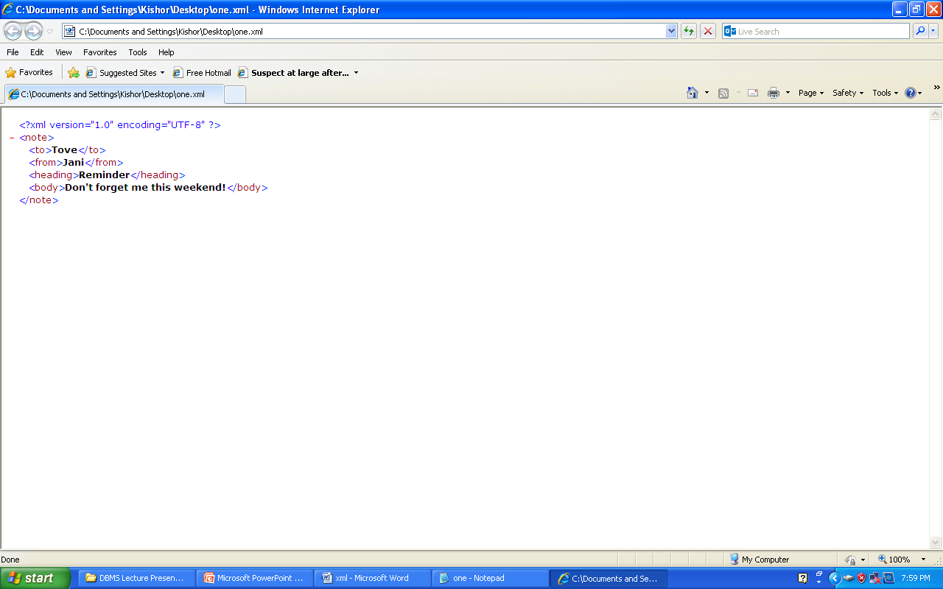
Viewing XML Files
Raw XML files can be viewed in all major browsers.
Don't expect XML files to be displayed as HTML pages.
Viewing XML Files
<?xml version="1.0" encoding="UTF-8"?>
<note>
<to>Tove</to>
<from>Jani</from>
<heading>Reminder</heading>
<body>Don't forget me this weekend!</body>
</note>

Slide 55
Look at the XML file above in your browser: note.xml
Notice that an XML document will be displayed with color-coded root and child elements.
A plus (+) or minus sign (-) to the left of the elements can be clicked to expand or collapse the element structure.
XML documents do not carry information about how to display the data.
Since XML tags are "invented" by the author of the XML document, browsers do not know if a tag like <table> describes an HTML table or a dining table.
Without any information about how to display the data, most browsers will just display the XML document as it is.

Slide 56
XML Document Types
An XML document with correct syntax is called "Well Formed".
A "Valid" XML document must also conform to a document type definition.
Valid XML Documents
A "valid" XML document is not the same as a "well formed" XML document.
A "valid" XML document must be well formed. In addition it must conform to a document type definition.
Rules that defines the legal elements and attributes for XML documents are called Document Type Definitions (DTD) or XML Schemas.
There are two different document type definitions that can be used with XML:
DTD - The original Document Type Definition
XML Schema - An XML-based alternative to DTD

Slide 57
When to Use a DTD/Schema?
With a DTD, independent groups of people can agree to use a standard DTD for interchanging data.
Your application can use a standard DTD to verify that the data you receive from the outside world is valid.
You can also use a DTD to verify your own data.
When to NOT to Use a DTD/Schema?
XML does not require a DTD/Schema when you are experimenting with XML, or when you are working with small XML files, creating DTDs may be a waste of time.

Slide 58
XML DTD
An XML document with correct syntax is called "Well Formed".
An XML document validated against a DTD is "Well Formed" and "Valid".
Valid XML Documents
A "Valid" XML document is a "Well Formed" XML document, which also conforms to the rules of a DTD:
<?xml version="1.0" encoding="UTF-8"?>
<!DOCTYPE note SYSTEM "Note.dtd">
<note>
<to>Tove</to>
<from>Jani</from>
<heading>Reminder</heading>
<body>Don't forget me this weekend!</body>
</note>

Slide 59
The DOCTYPE declaration, in the example above, is a reference to an external DTD file.
The purpose of a DTD is to define the structure of an XML document. It defines the structure with a list of legal elements:
The content of the file is shown below.
<!DOCTYPE note
[
<!ELEMENT note (to,from,heading,body)>
<!ELEMENT to (#PCDATA)>
<!ELEMENT from (#PCDATA)>
<!ELEMENT heading (#PCDATA)>
<!ELEMENT body (#PCDATA)>
]>
The DTD above is interpreted like this:
!DOCTYPE note defines that the root element of the document is note
!ELEMENT note defines that the note element must contain four elements: "to, from, heading, body"
!ELEMENT to defines the to element, from element ,heading element ,body element to be of type "#PCDATA“
#PCDATA means parse-able text data.

Slide 60
Using DTD for Entity Declaration
A doctype declaration can also be used to define special characters and character strings, used in the document:
Example
<?xml version="1.0" encoding="UTF-8"?>
<!DOCTYPE note [
<!ENTITY nbsp "&#xA0;">
<!ENTITY writer "Writer: Donald Duck.">
<!ENTITY copyright "Copyright: W3Schools.">
]>
<note>
<to>Tove</to>
<from>Jani</from>
<heading>Reminder</heading>
<body>Don't forget me this weekend!</body>
<footer>&writer;&nbsp;&copyright;</footer>
</note>

Slide 61
Why Use a DTD?
With a DTD, independent groups of people can agree on a standard for interchanging data.
With a DTD, you can verify that the data you receive from the outside world is valid.

Slide 62
Geographic Data
Geographic data refers to information that is tied to specific locations or geographic areas.
It plays a crucial role in various fields, including urban planning, environmental studies, transportation, and logistics.

Slide 63
Sources of Geographic Data:
Satellite Imagery: Collected from satellites for mapping and monitoring.
GPS Data: Collected from GPS devices to provide precise location information.
Government Agencies: Many governments provide open geographic data (e.g., census data, land use).
Crowdsourced Data: Data contributed by users, such as OpenStreetMap.

Slide 64
Applications of Geographic Data:
Urban Planning: Used to analyze land use, zoning, and infrastructure planning.
Environmental Management: Helps in resource management, conservation efforts, and monitoring environmental changes.
Transportation: Analyzing traffic patterns, route optimization, and logistics.
Geographic Information Systems (GIS): Tools that allow users to create, analyze, and visualize geographic data.
Location-Based Services: Applications like ride-sharing, navigation, and real estate listings rely on geographic data.

Slide 65
Geographic Database
A geographic database is designed to store, manage, and analyze geographic data, enabling users to perform spatial queries and analyses.
These databases support the storage of both spatial and non-spatial data, allowing for comprehensive geographic information systems (GIS) applications.
Types of Geographic Databases:
Spatial Databases:
Geographic Information Systems (GIS):
NoSQL Databases with Spatial Capabilities:

Slide 66
Popular Geographic Databases:
PostGIS
Oracle Spatial:
Microsoft SQL Server with Spatial Extensions:
MongoDB:
Cassandra with GeoMesa:

Slide 67
Geometric data
Geometric data is a type of data that is represented on a two-dimensional surface, such as a map or floor plan.
It can be stored in a database management system (DBMS) as points, lines, or polygonal shapes.
Geometric data refers to information that describes the shape, size, and spatial relationships of geometric objects.
It is often used in fields such as computer graphics, geographic information systems (GIS), and computational geometry.

Slide 68
Types of Geometric Data:
Points: Represents specific locations in a coordinate system (e.g., a location on a map).
Lines: Describes linear features connecting two or more points (e.g., roads, rivers).
Polygons: Encloses a space defined by a series of connected lines, forming a shape (e.g., countries, lakes).
3D Objects: Extends beyond 2D shapes to include volume and depth, represented by structures like cubes, spheres, and complex surfaces.
Meshes: Used in computer graphics to represent 3D objects through vertices, edges, and faces.

Slide 69
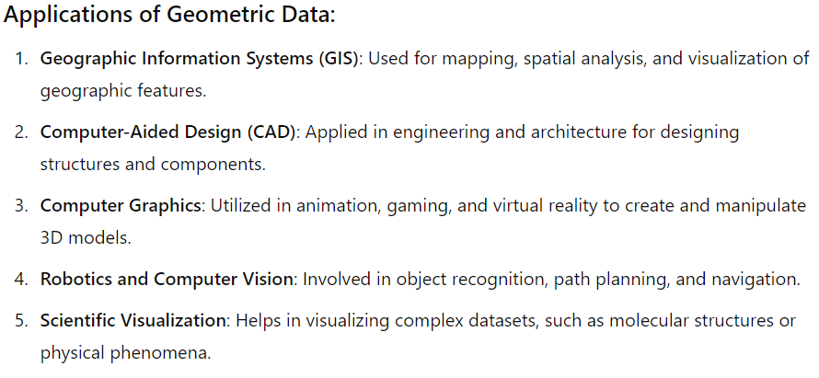

Slide 70
A geometric database is designed specifically to store, manage, and manipulate geometric data, which includes points, lines, polygons, and other geometric shapes.
These databases support spatial data types and operations, making them ideal for applications that require geometric computations, such as geographic information systems (GIS), computer-aided design (CAD), and robotics.

Slide 71
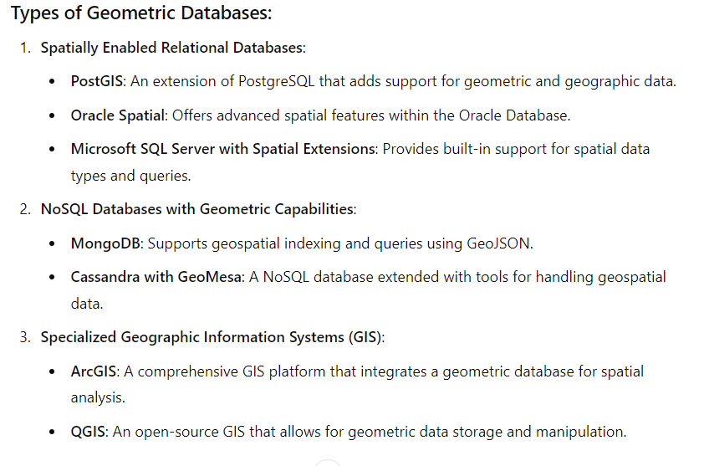

Slide 72
End of Unit VI

